Slide 1

SREENIDHI INSTITUTE OF SCIENCE AND TECHNOLOGY
(AN AUTONOMOUS INSTITUTION Approved by UGC)
Yamnampet, Ghatkesar, R.R. District -501 301
DEPARTMENT OF
COMPUTER SCIENCE & ENGINEERING
PROJECT-1 ABSTRACT PRESENTATION
On
HANDWRITTEN EQUATION SOLVER
(USING CNN)
BATCH NO: B15
SHREYA MALRAJU
(18311A0599)
Under the guidance of
Internal Guide Project Coordinator Head of the Department
Mr. R.Arun Kumar Mrs. Pallepati Vasavi Dr. Aruna Varanasi

Slide 2
CONTENTS
Abstract
Introduction
Existing System
Proposed System
Scope of the project
Software and Hardware Requirements
Dataset Description
Architecture Diagram
UML Diagrams
Methodologies Used
Results and Output
Conclusions
Future Scope
References

Slide 3
ABSTRACT
During the second semester of 3rd year, I was a part of the project Handwritten Digit Recognition System which classifies the handwritten numbers into its respective class ranging from 0-9.
This semester, as an extension to the previous project, I am in a process of developing a system which solves Handwritten Arithmetic Expressions.
Methods of CNN is used to train the data , which contains numbers from 0-9 and arithmetic operators ( such as + , - , *, / ) hence classification of elements is done into 13 classes.

Slide 4
INTRODUCTION
Humans can see and visually sense the world around them by using their eyes and brain. Computer vision works on enabling computers to see and process images in the same way that human vision does. Several algorithms are developed in the area of computer vision to recognize images.
The goal of my work will be to create a model that will be able to identify and determine the handwritten digits and arithmetic operators from its image with better accuracy and compute the value of that expression after solving. Using the concepts of Convolutional Neural Network and extended MNIST dataset, this problem can be solved.
We can extend this model to recognize combination of numbers and digits from two or more polynomial equations and try solving them.

Slide 5
EXISTING SYSTEM
SNO | YEAR | TITLE | AUTHORS | ALGORITHM USED | ACCURACY
1 | 2018 | Maximum Margin Clustering Made Practical | Kai Zhang Ivor W. Tsang James T. Kwok | Maximum Margin Clustering | 74%
2 | 2019 | A paradigm for handwriting-based intelligent tutors. | LisaAnthony JieYangKenneth R.Koedinger | Optical Character Recognition | 78%
3 | 2020 | ANN-Based Handwritten Digit Recognition and Equation Solver | Amarjit Malhotra Megha Gupta Rishabh Yadav | Artificial Neural Networks | 89%

Slide 6
PROPOSED SYSTEM
Convolutional Neural Networks
Advanced or Extended MNIST dataset
Tensorflow, Keras
PROCESS :
Load Dataset
CNN Design
Pre-Processing
Training
Testing
Classification and Solving the equation

Slide 7
SOFTWARE REQUIREMENTS
Jupyter Notebook / Google Colaboratory
Python version > 3.0
Libraries: Tensorflow , Keras , numpy , scipy , matplotlib etc.

Slide 8
HARDWARE REQUIREMENTS
System with Windows 10 / Ubuntu Operating system / Mac OS
RAM preferably > 8GB
GPU (Optional)
Memory space > 500GB for faster training of data

Slide 9
DATASET
Here MNIST data set is extended which is public
MNIST previously consisted of handwritten digits from 0-9
It is now extended by adding images of handwritten arithmetic operators such as + , - , * , /
The sizes of images are 28 x 28
It contains 85,709 images.

Slide 10
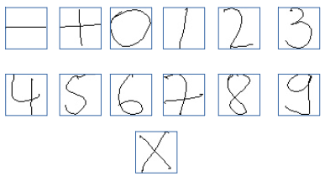

Slide 11
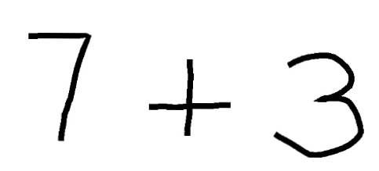


Slide 12
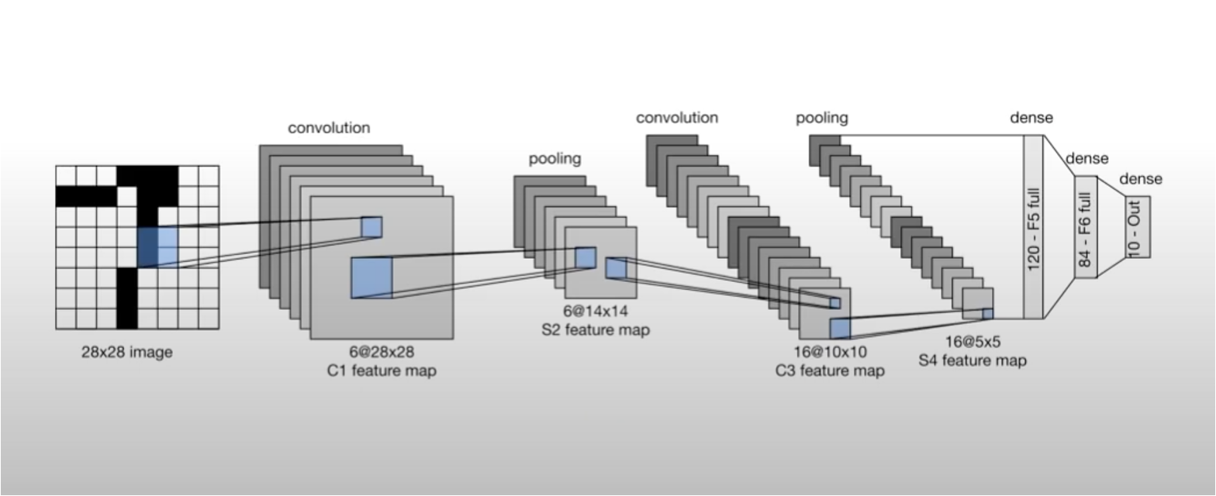
ARCHITECTURE DIAGRAM

Slide 13
UML DIAGRAMS

Slide 14
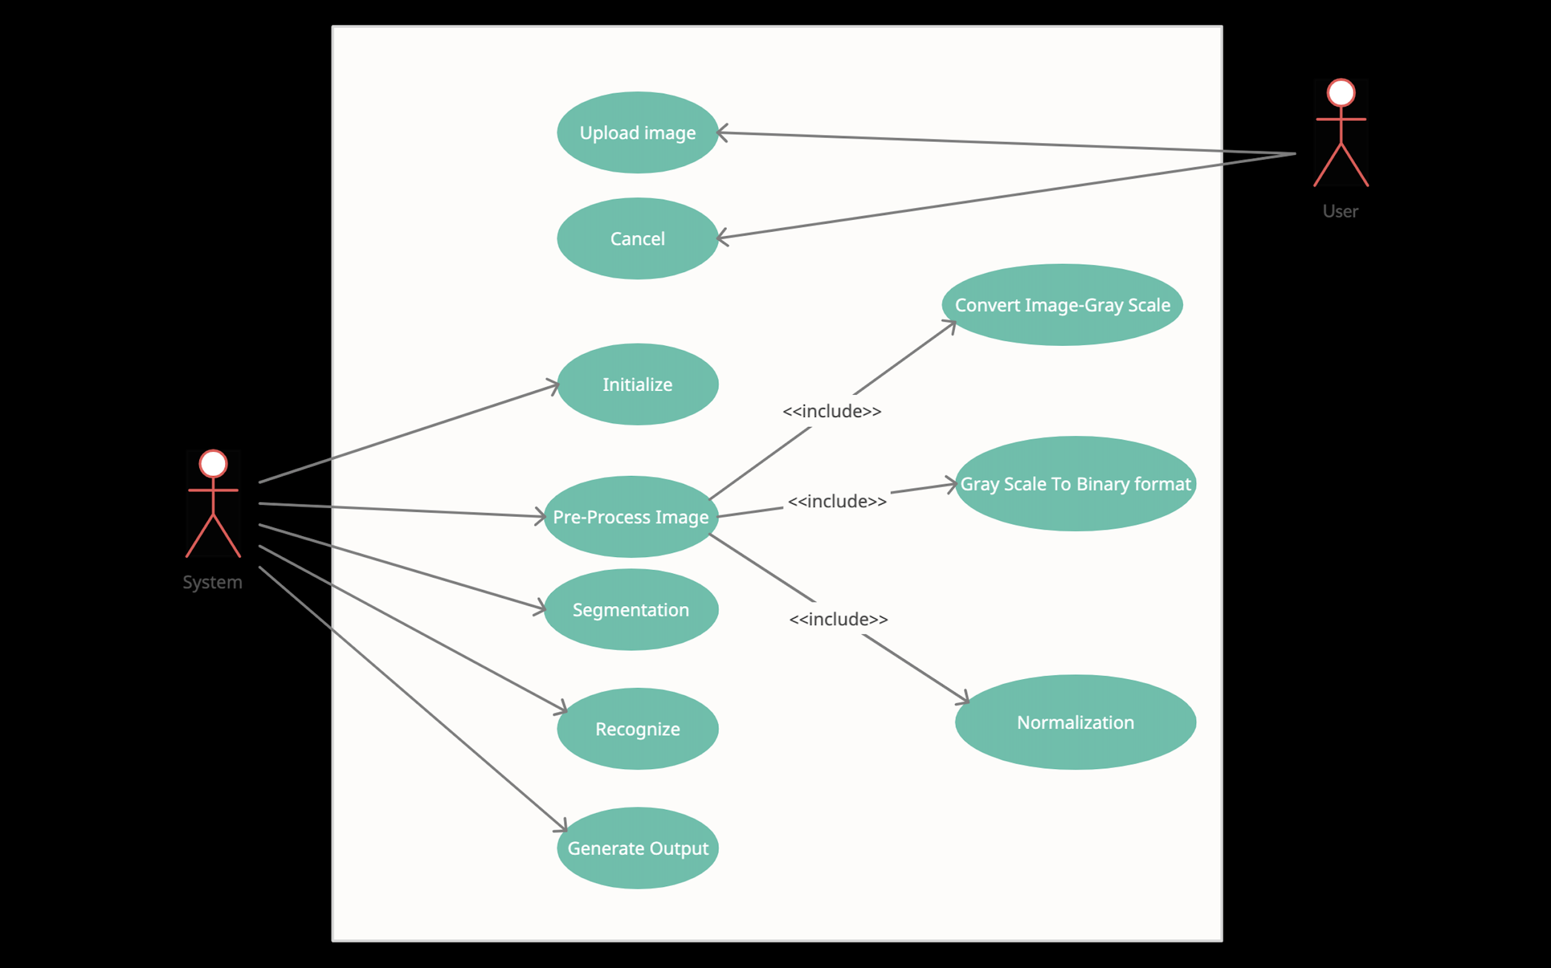
USE CASE DIAGRAM

Slide 15
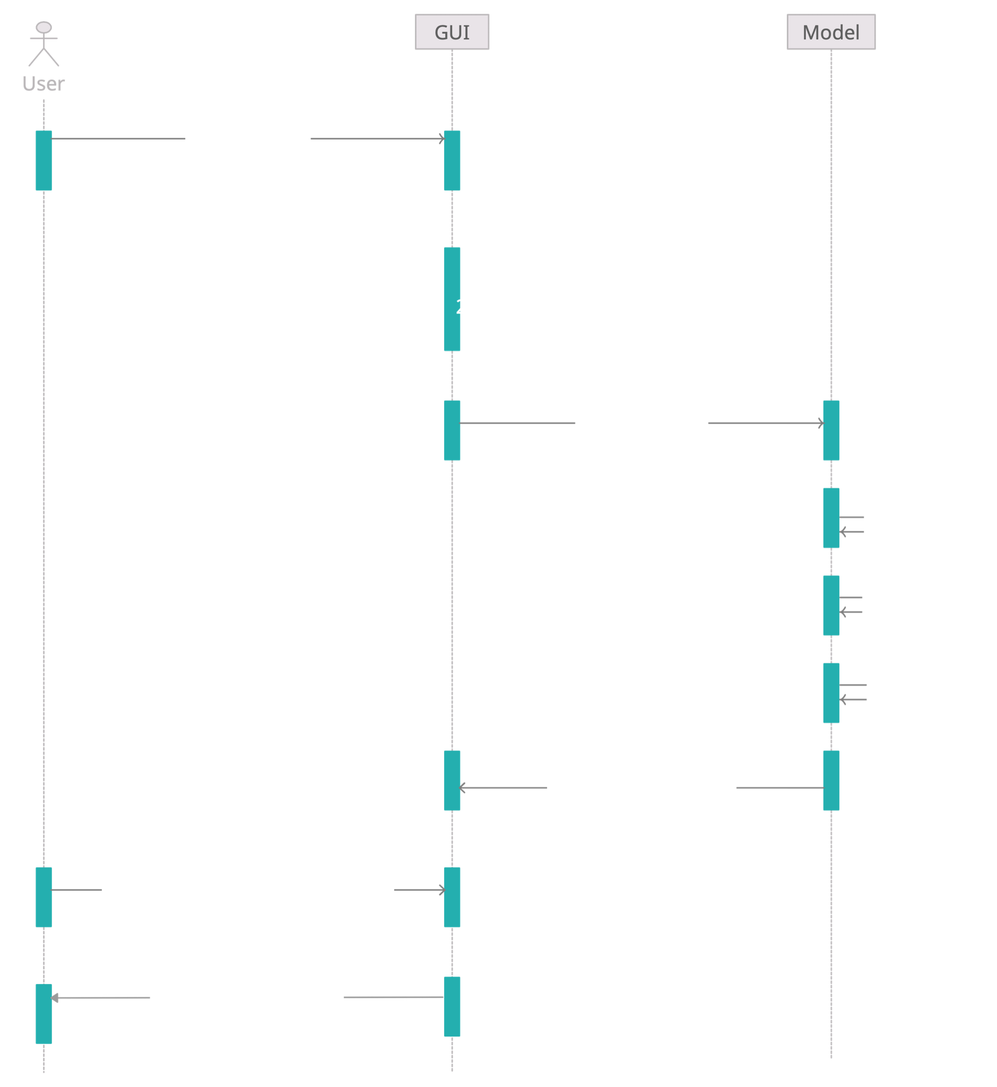
SEQUENCE DIAGRAM

Slide 16
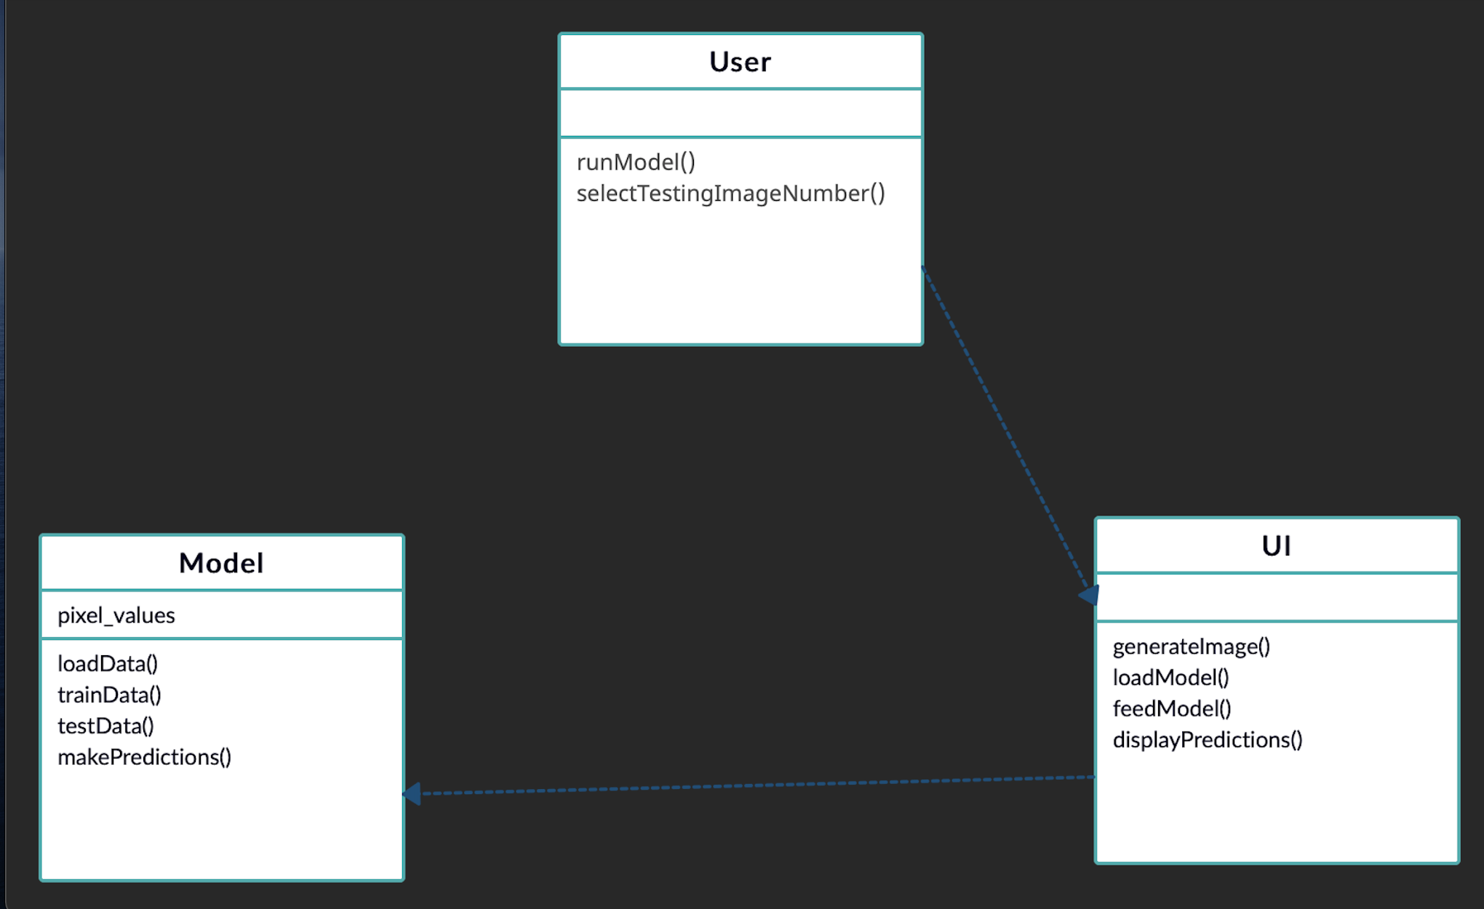
CLASS DIAGRAM

Slide 17
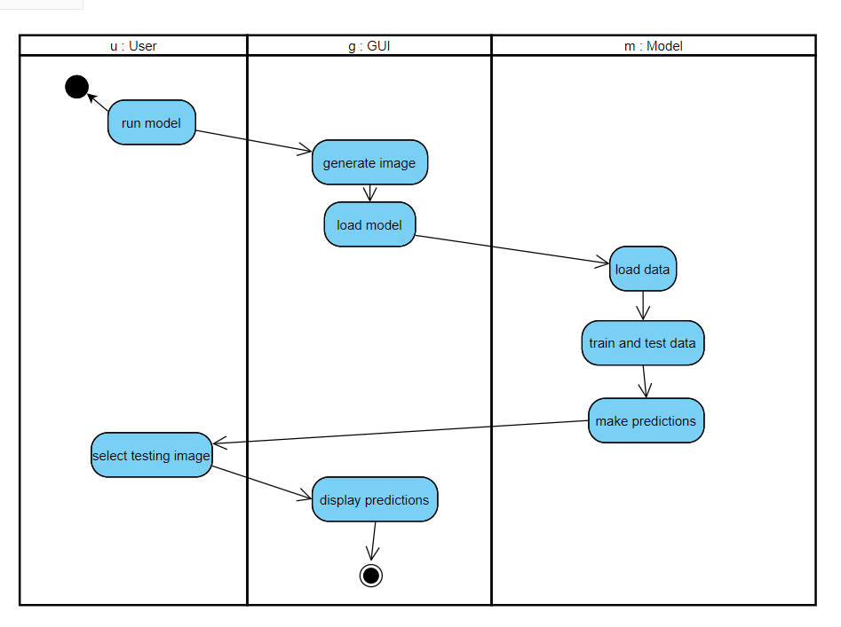
ACTIVITY DIAGRAM

Slide 18
METHODOLOGIES USED
Convolutional Neural Networks are a subclass of Deep Learning algorithms mainly used for analyzing visual imagery. High amounts of training data, increasing computational powers and advanced deep learning techniques have paved the way for CNNs to perform complex visual tasks .
This powerful visual architecture evolved over the years until, a paper by Yann LeCun et al. in 1998, formulated the famous LeNet-5 architecture. In this paper, the concept of convolutional and pooling layers was introduced.
Today, many companies employ CNN for analyzing visual imagery. The following are a few examples:
Tesla for Autopilot
Google Photos for Image Classification
Facebook Artificial Intelligence Research (FAIR) for Language Translation

Slide 19
RESULTS AND OUTPUT

Slide 20
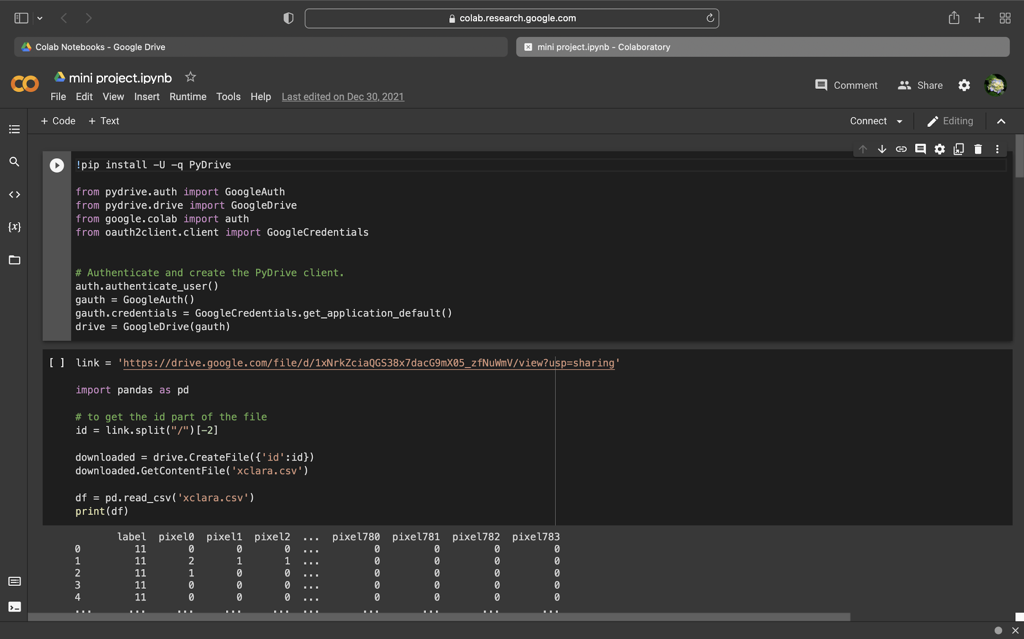

Slide 21
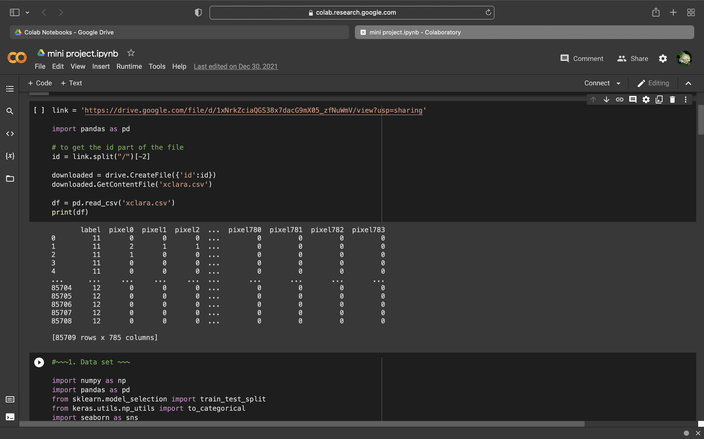

Slide 22
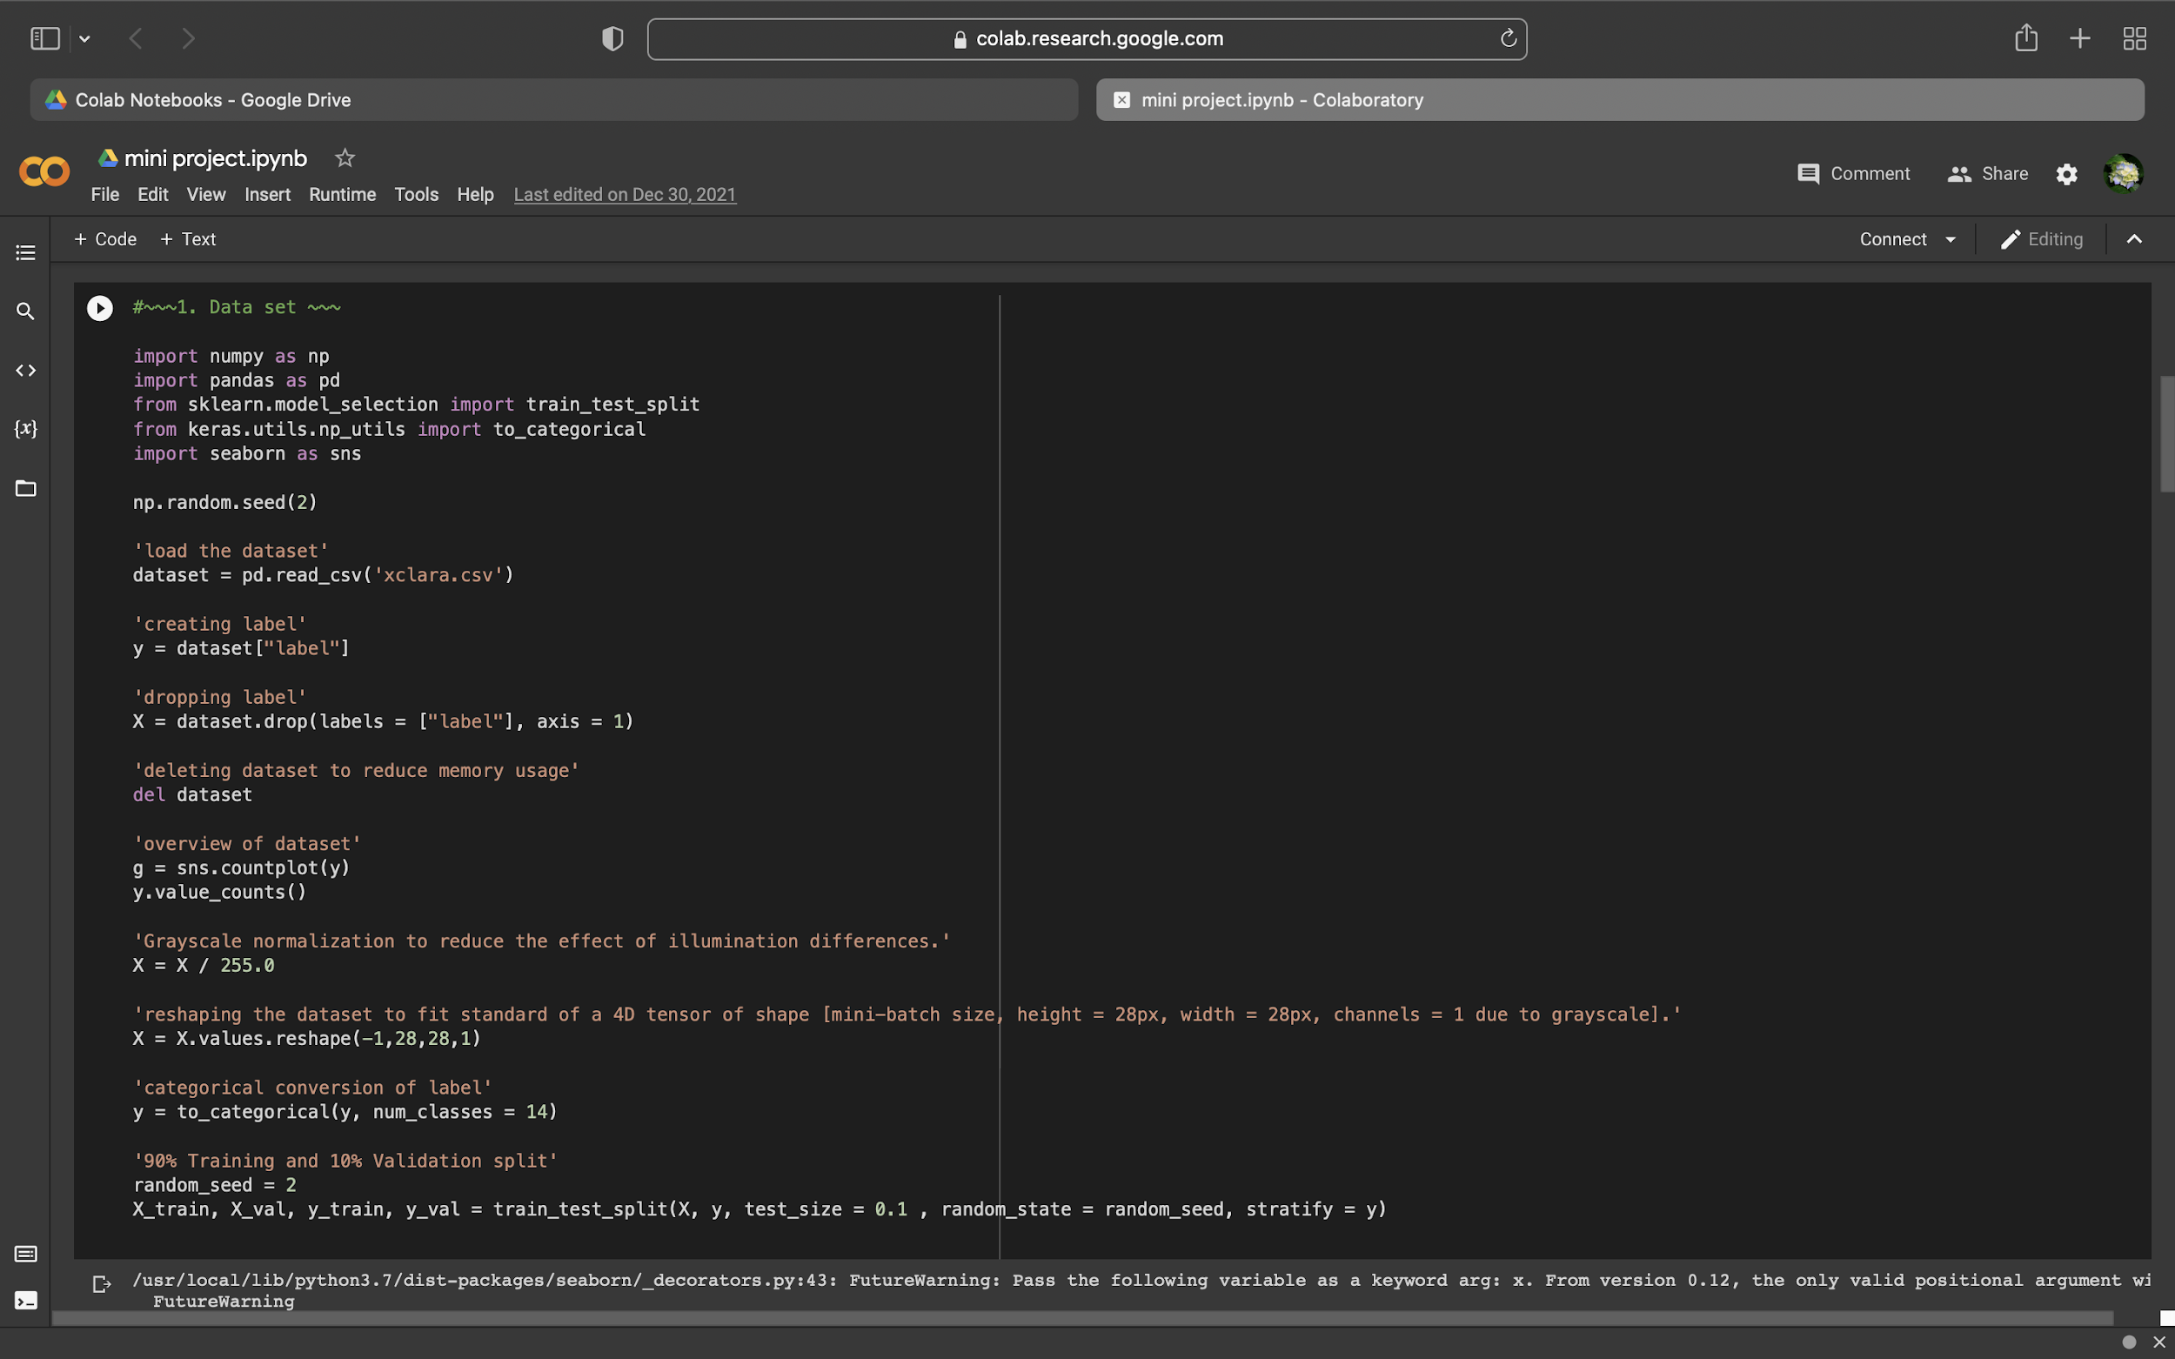

Slide 23
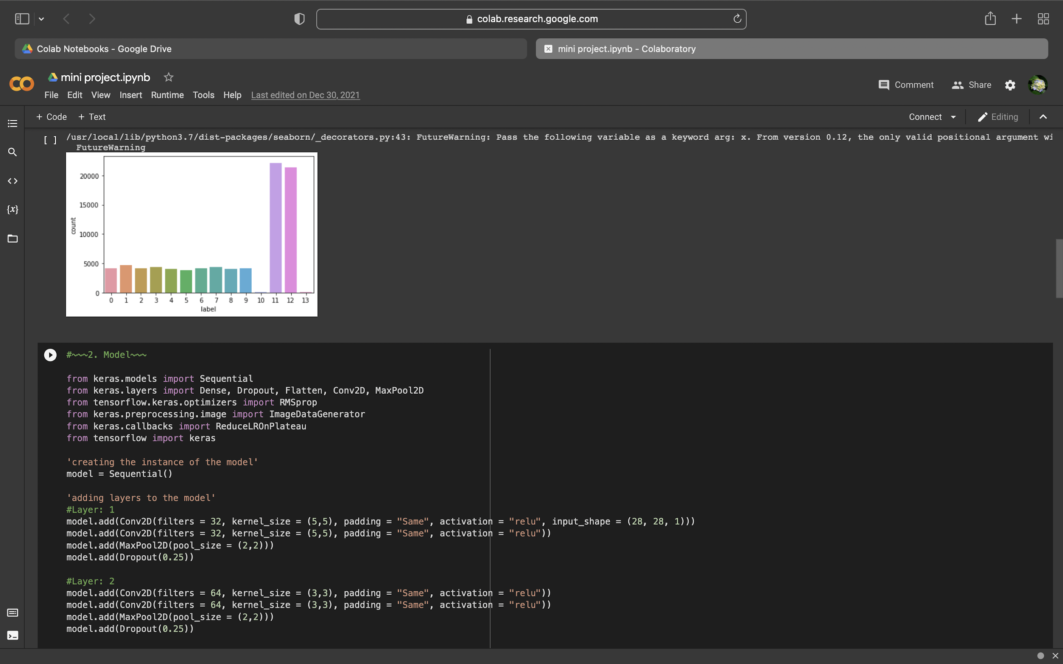

Slide 24
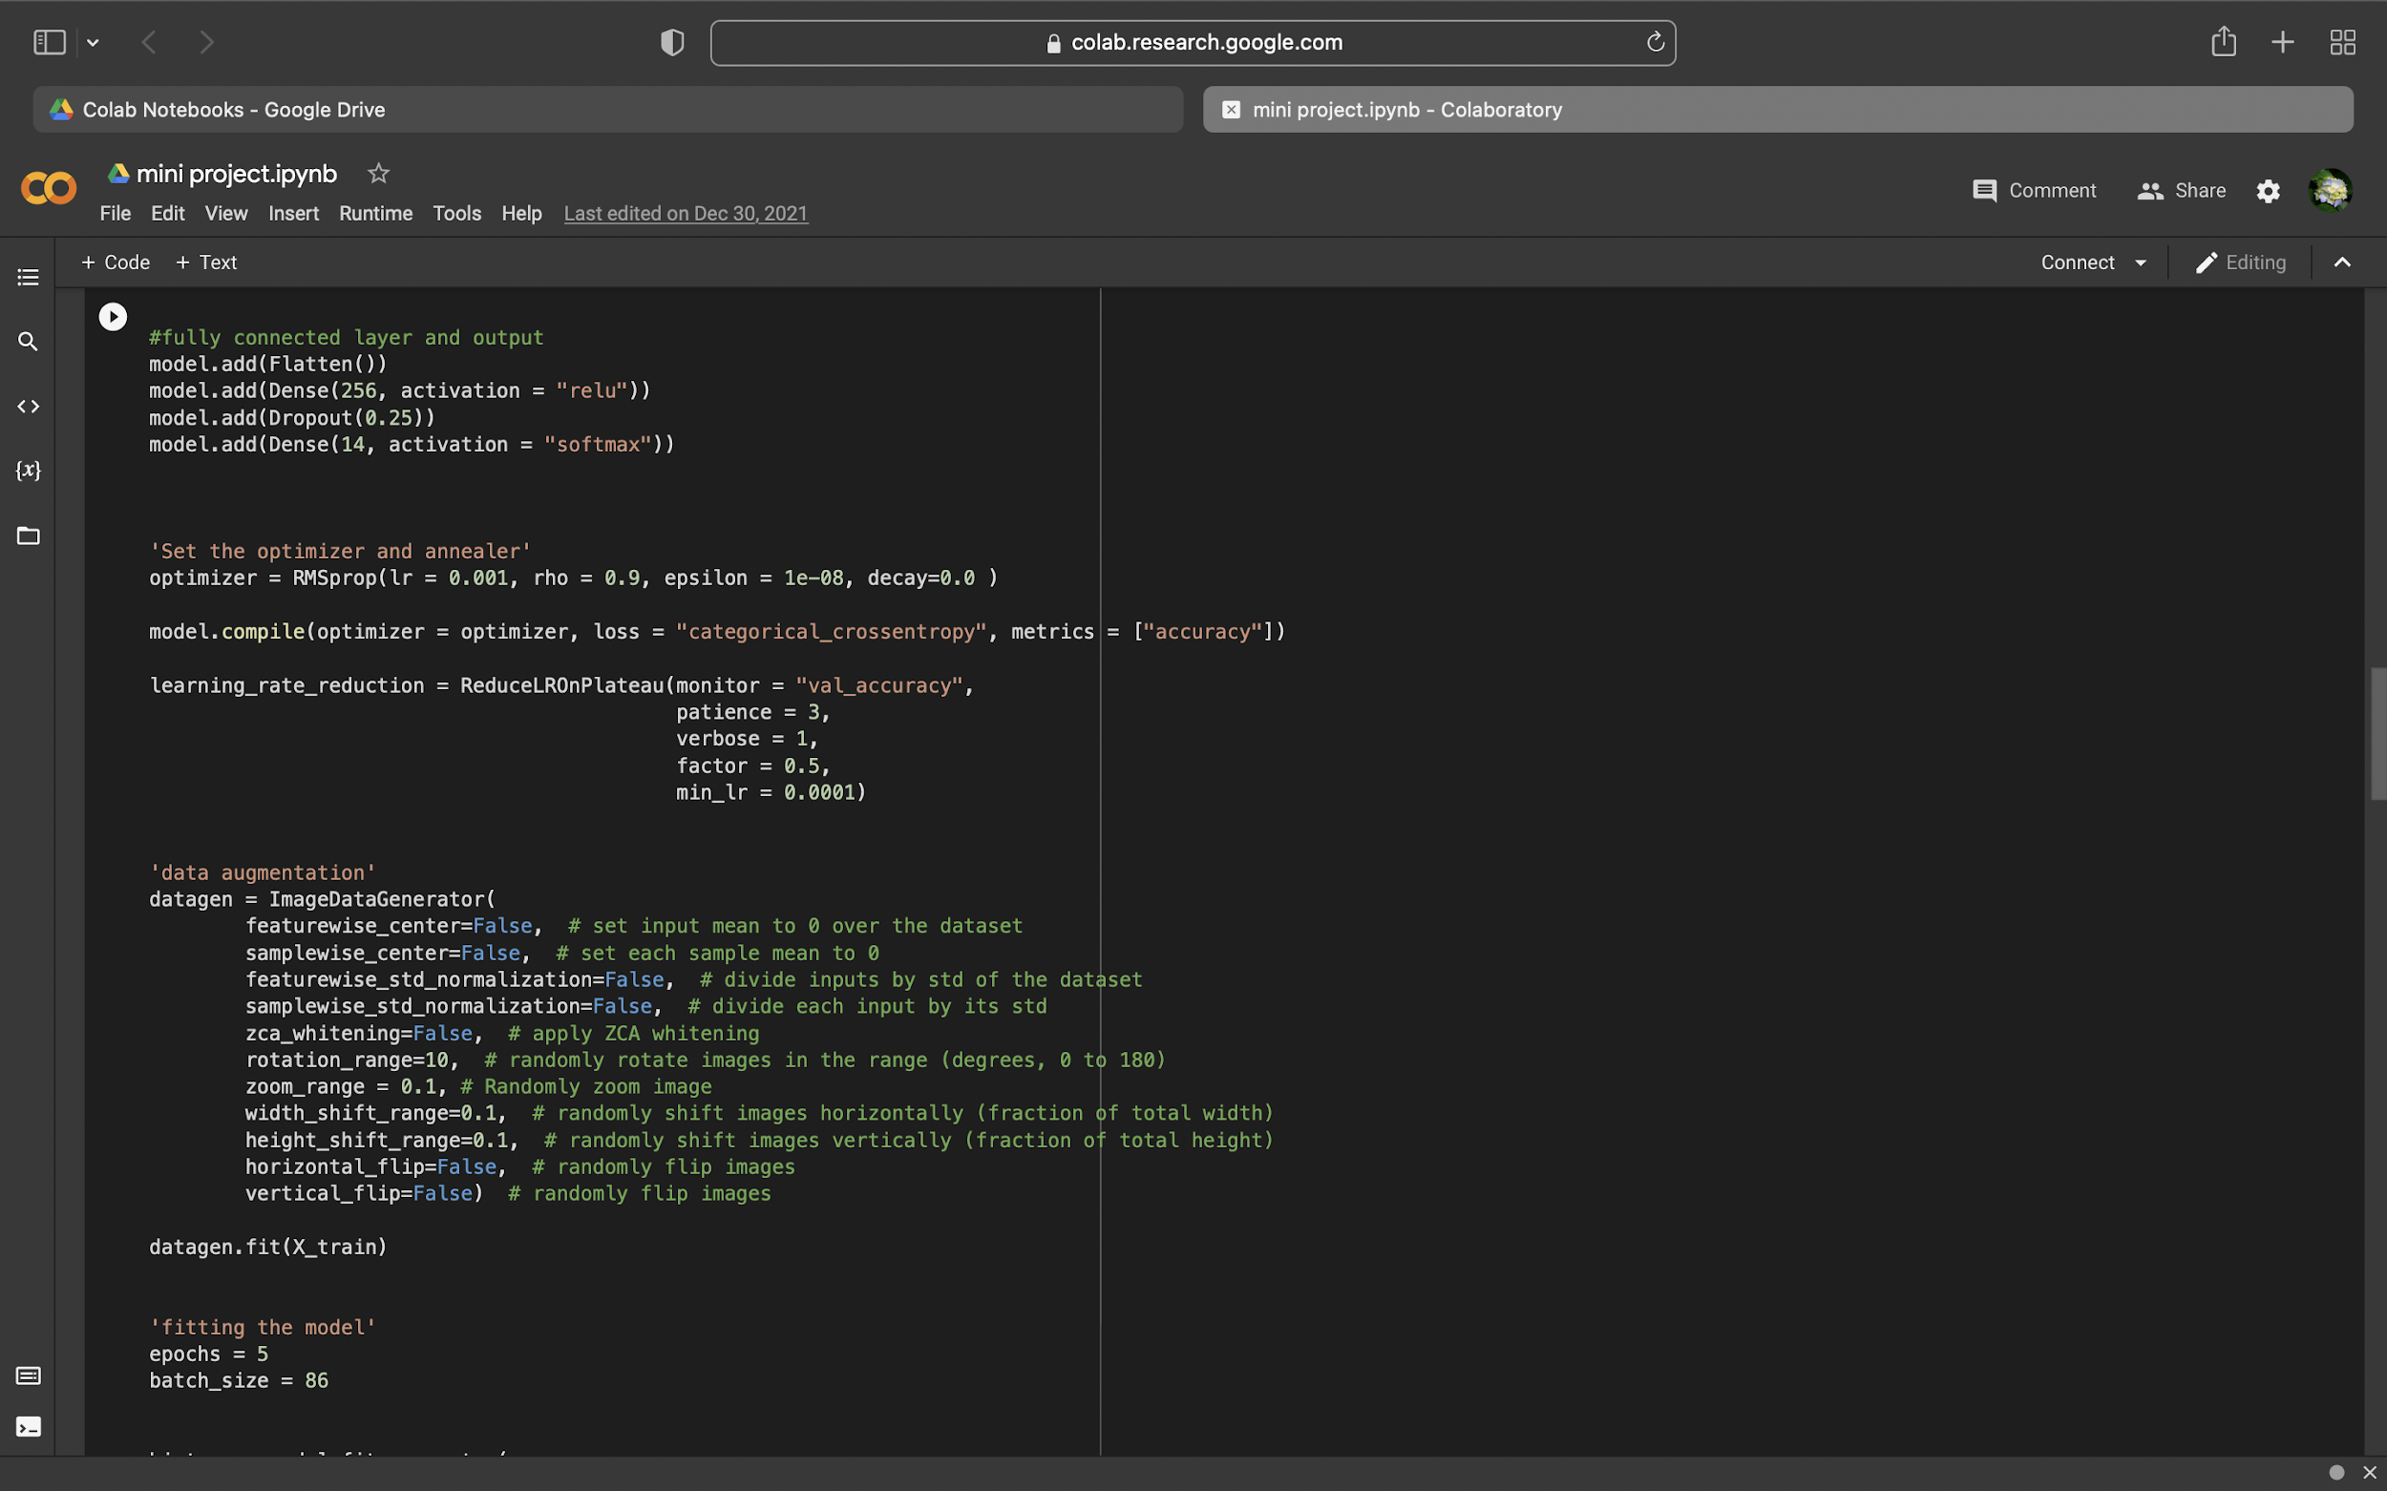

Slide 25
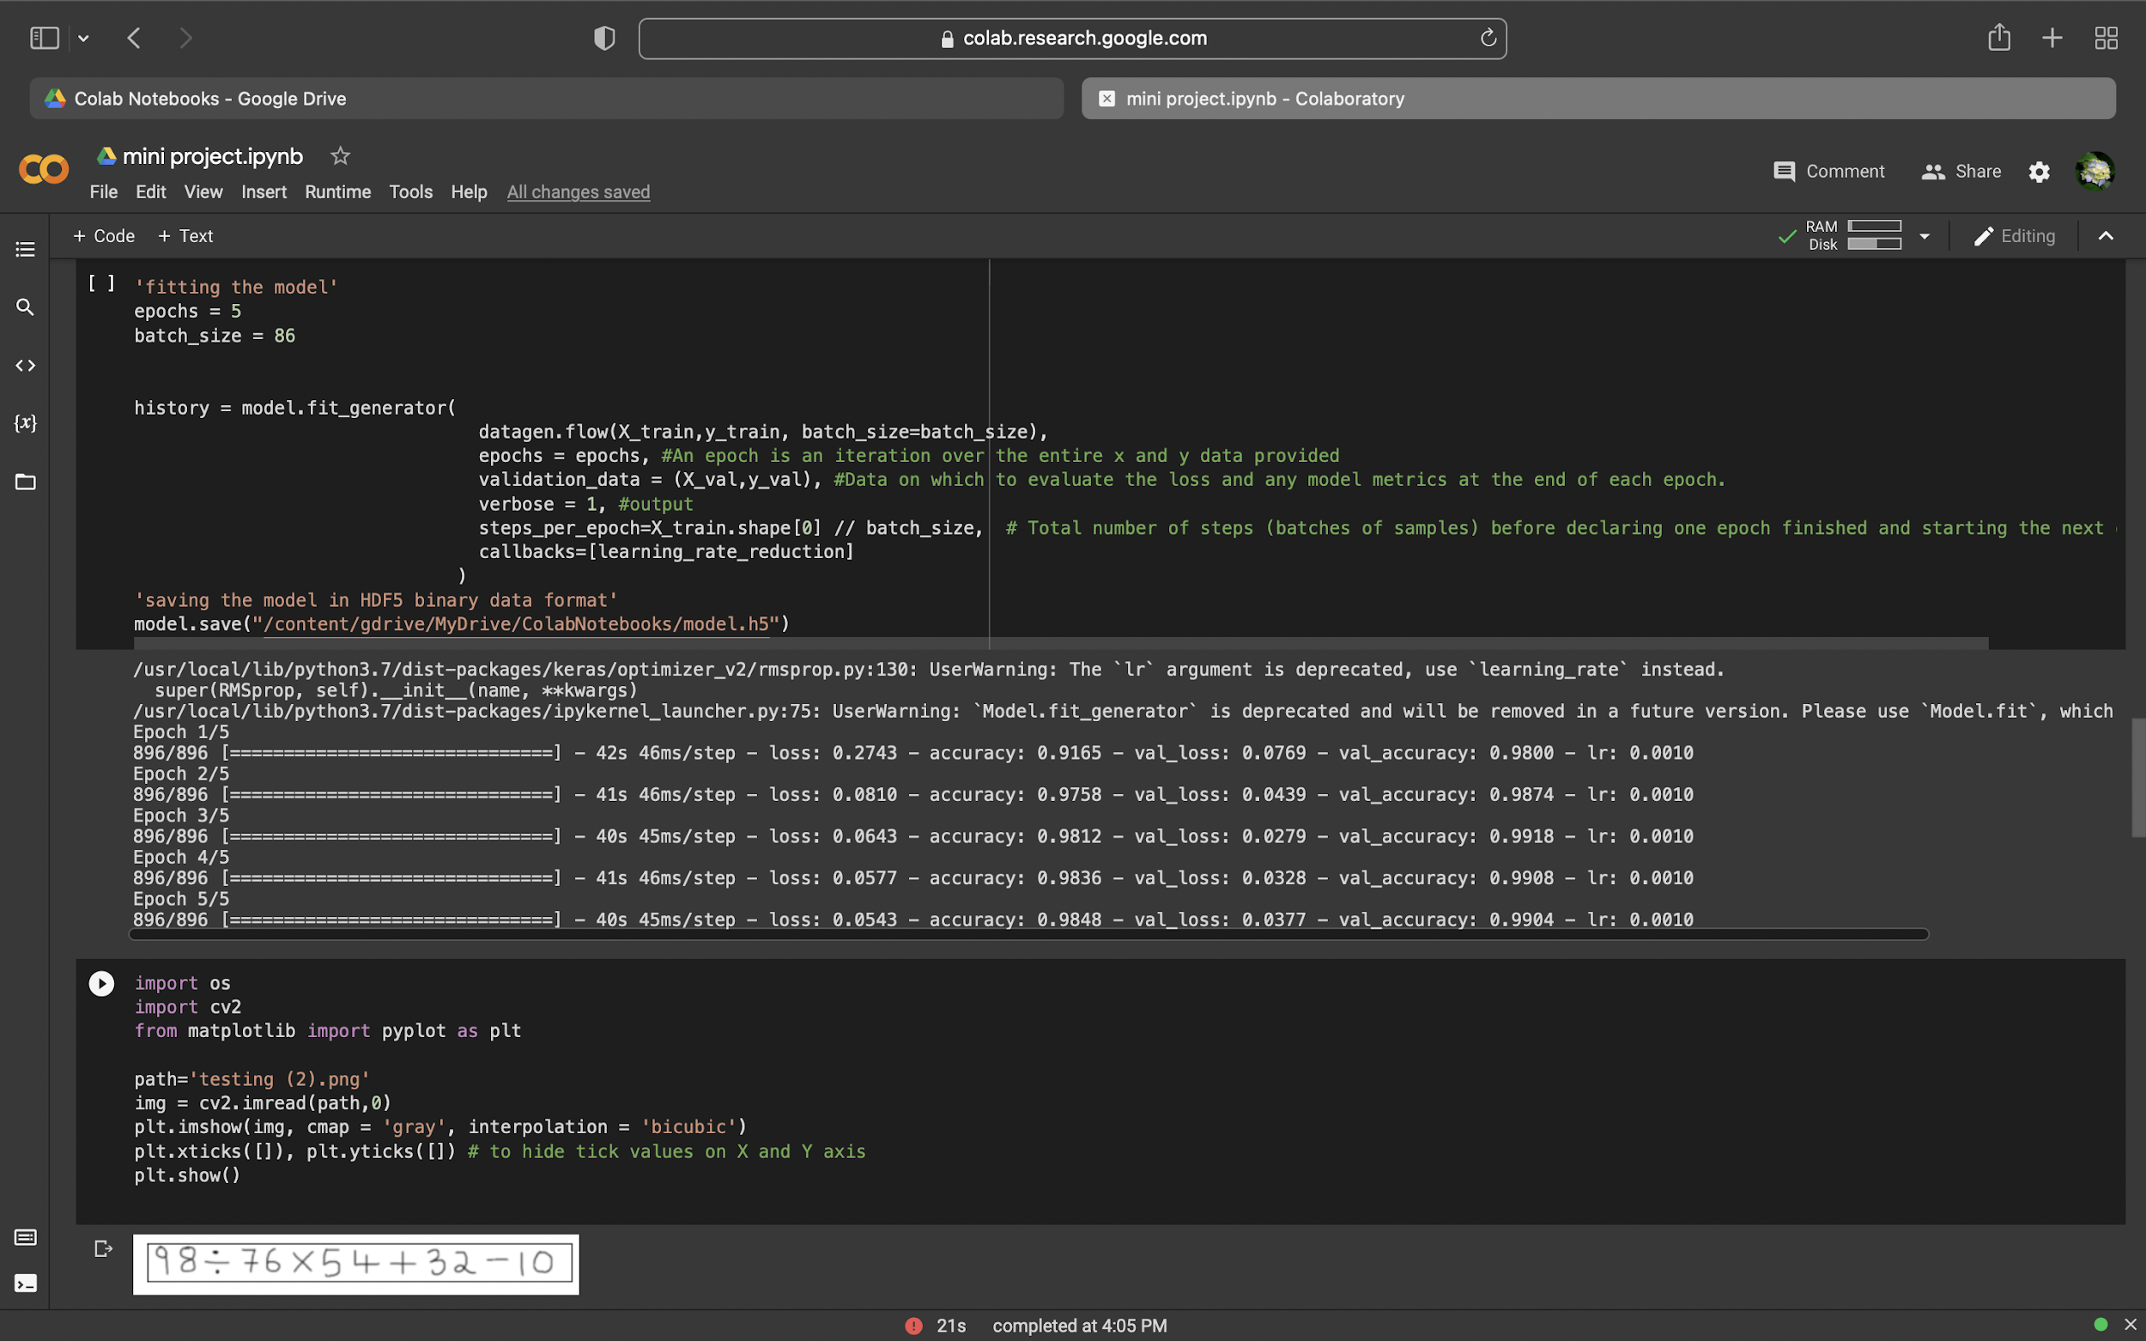

Slide 26
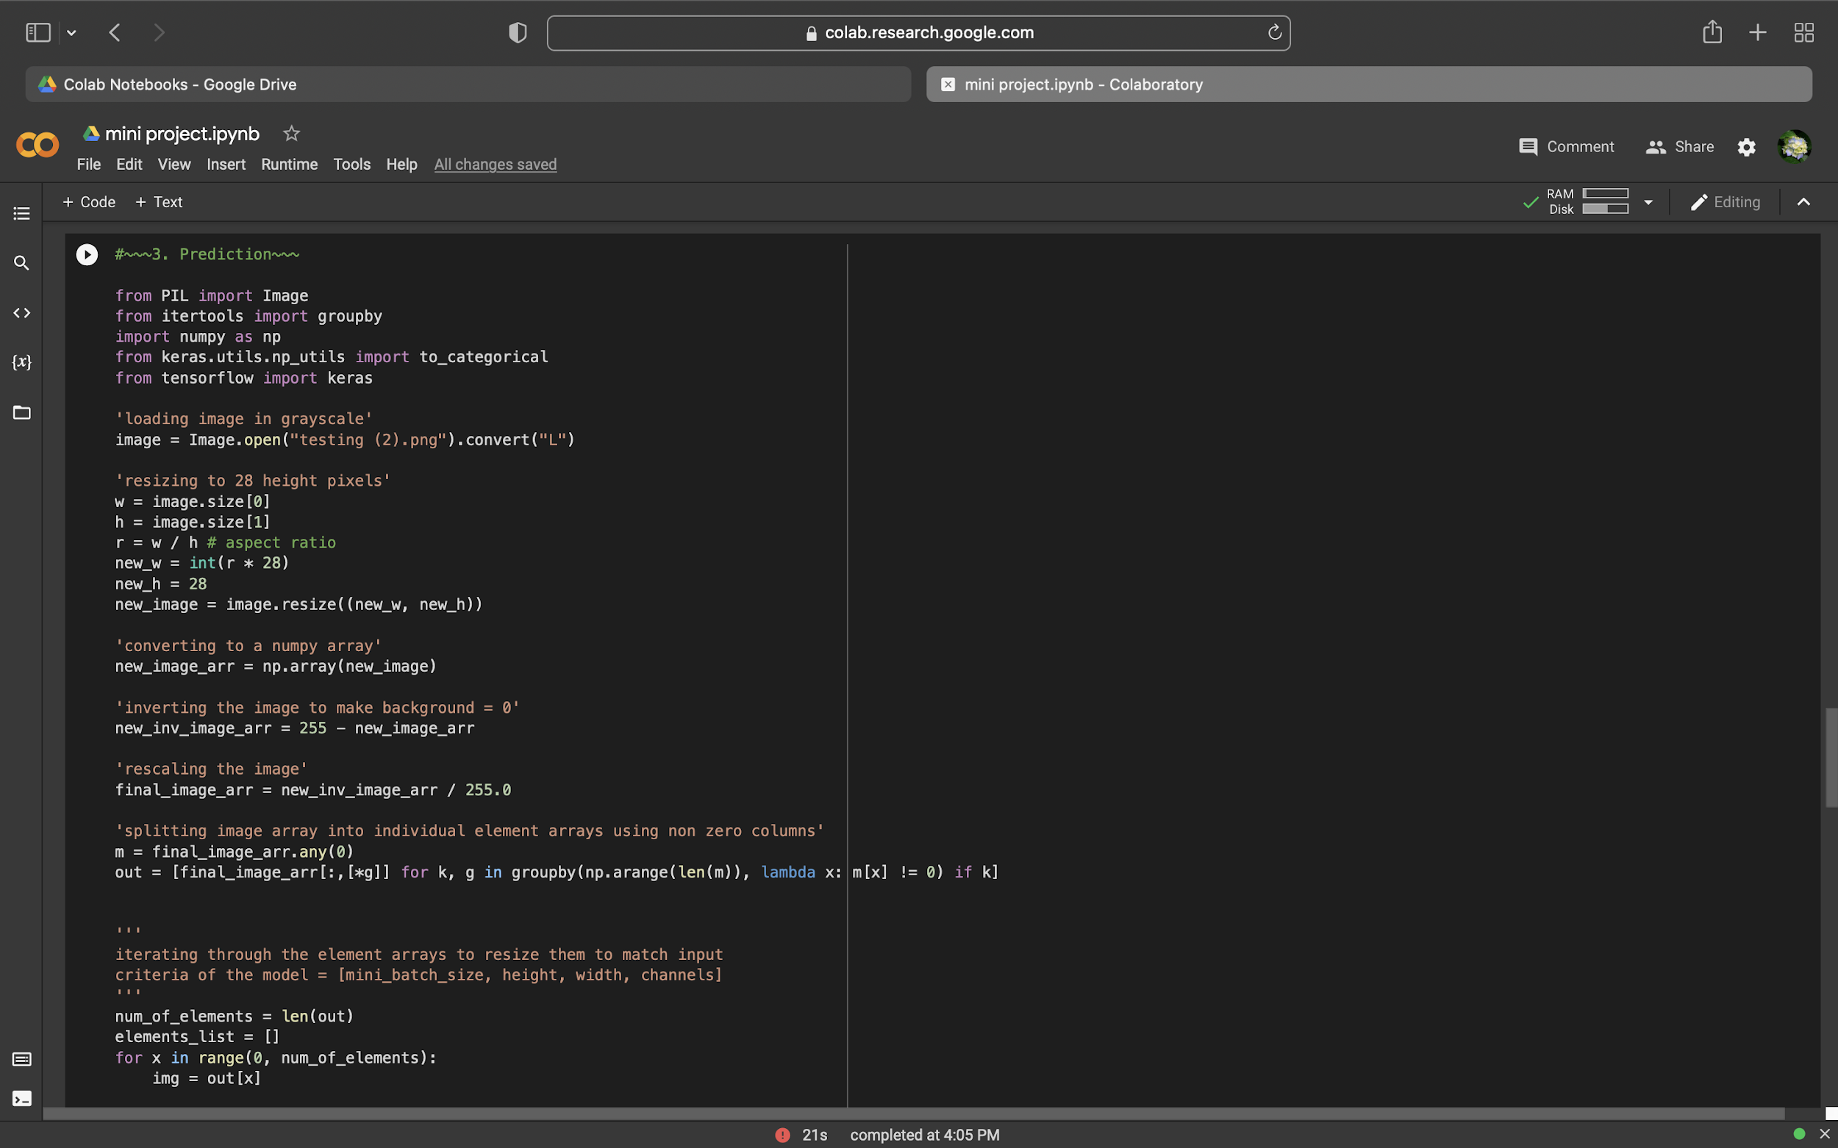

Slide 27
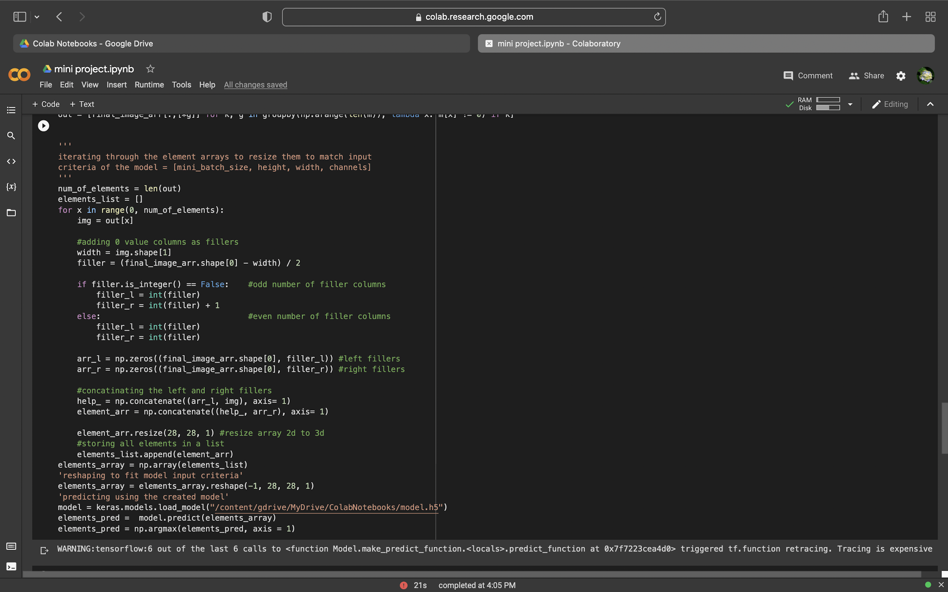

Slide 28
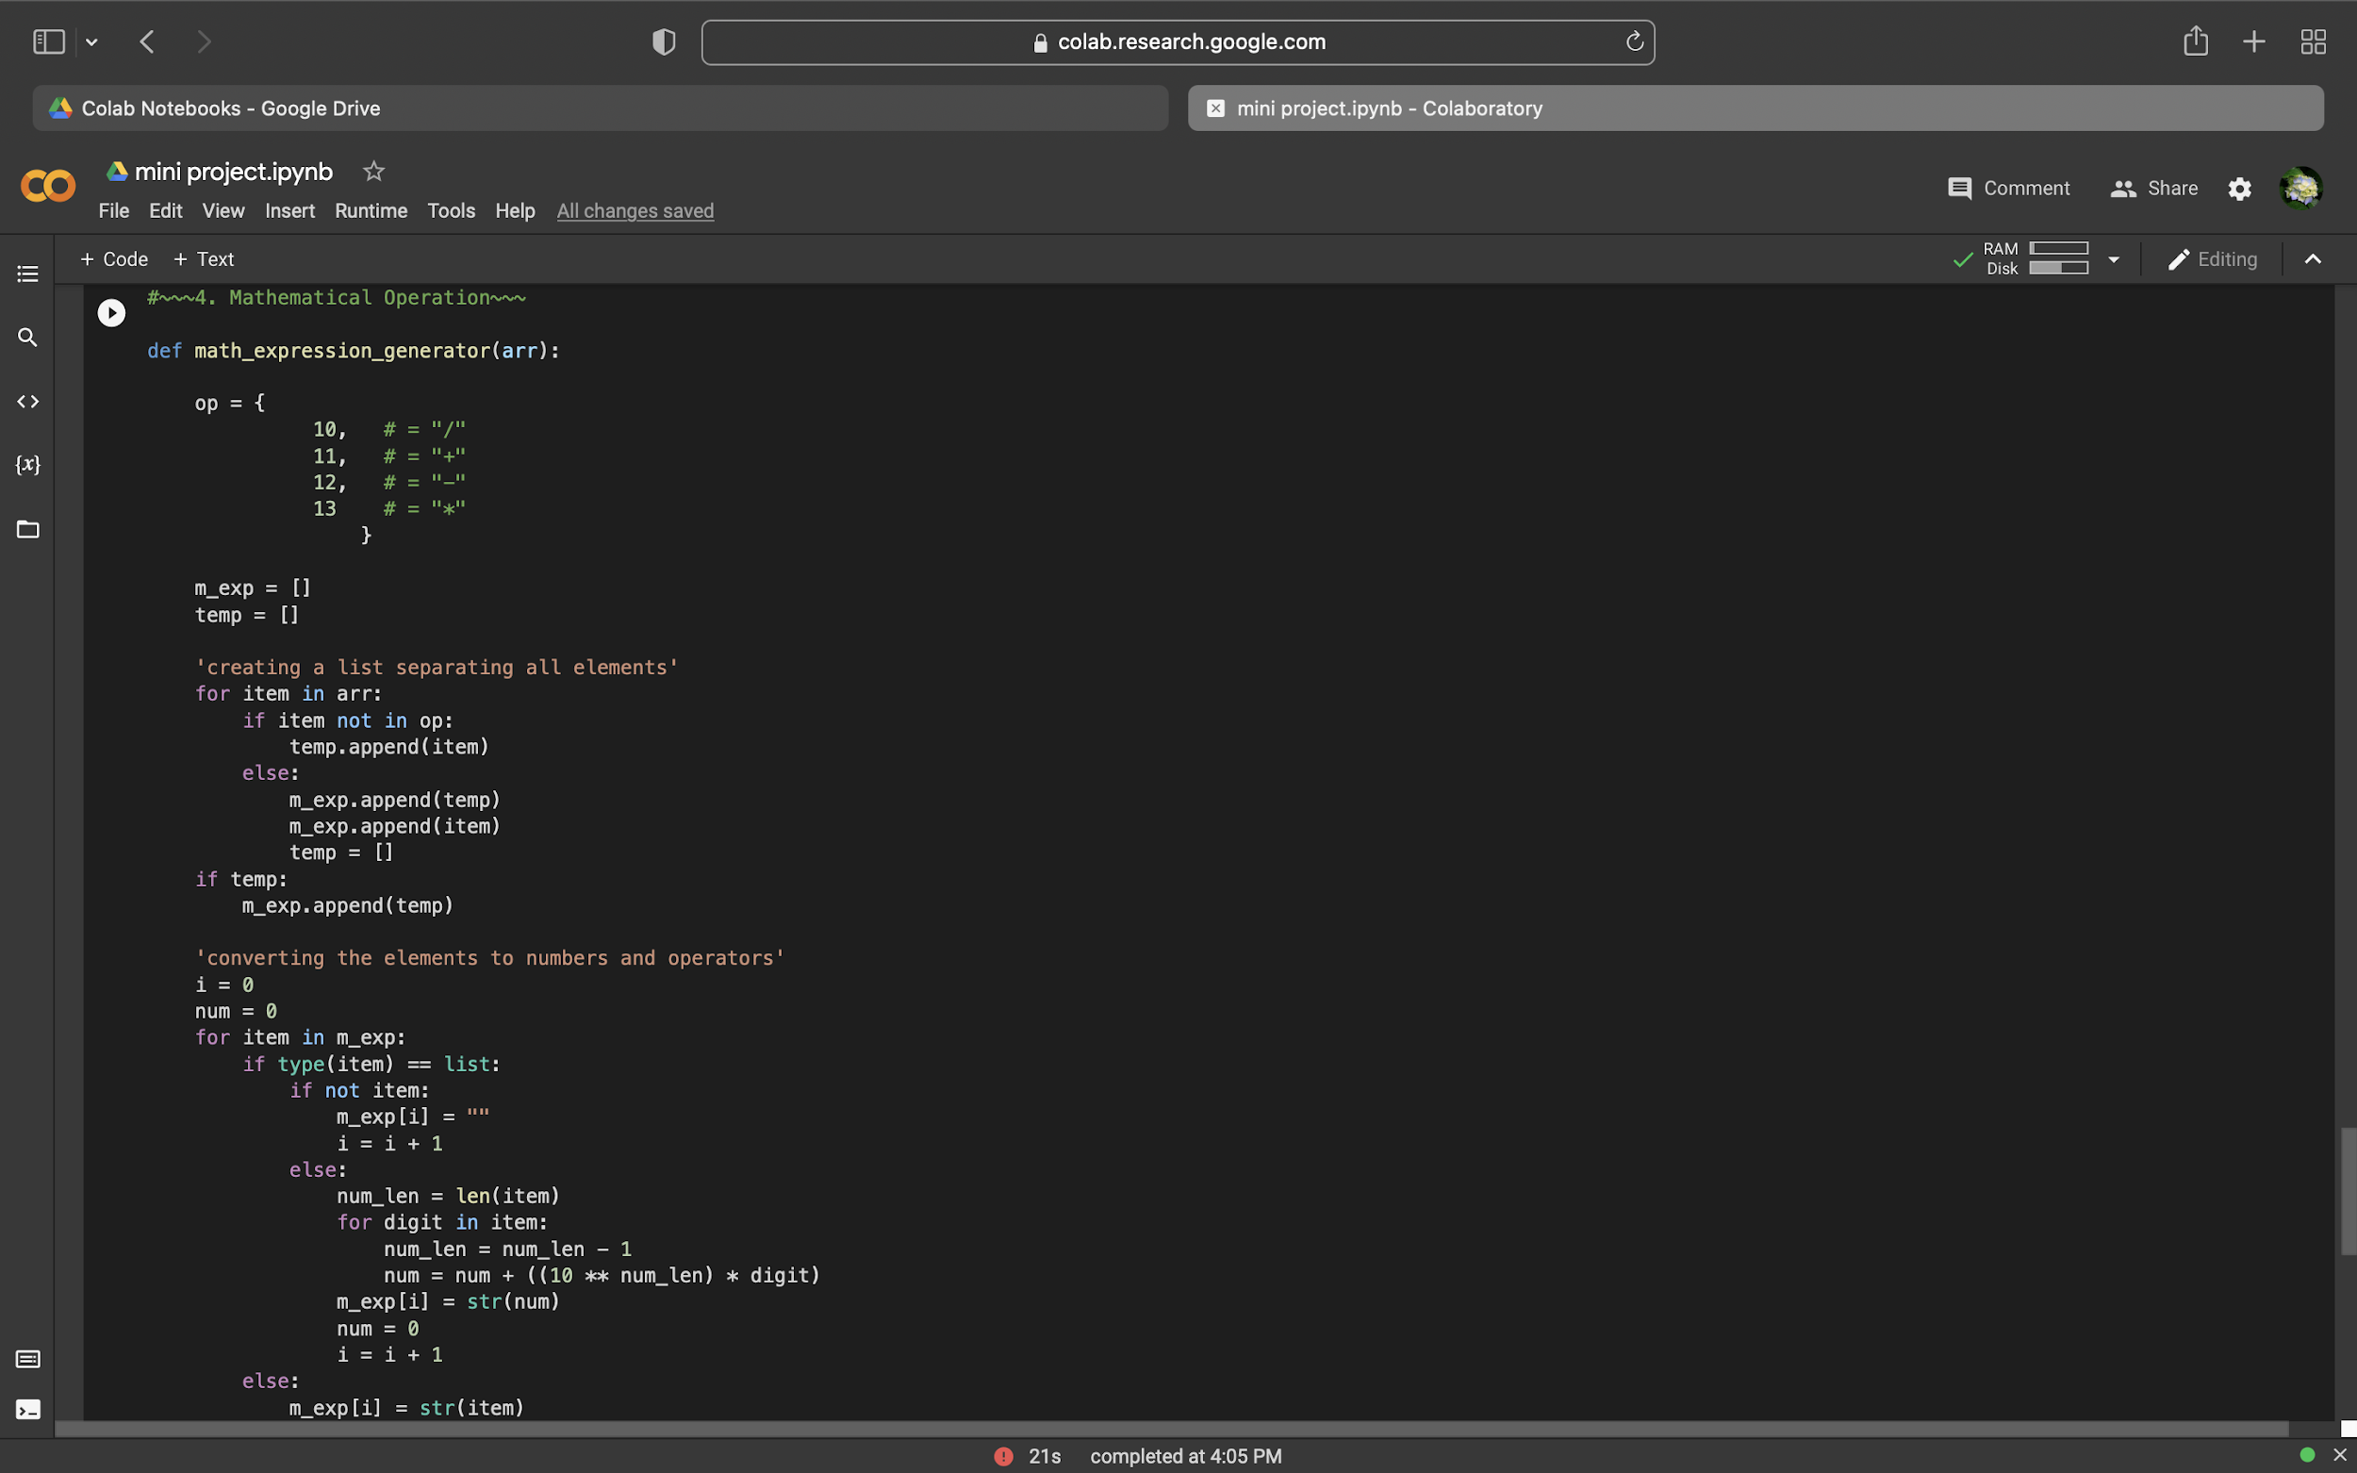

Slide 29
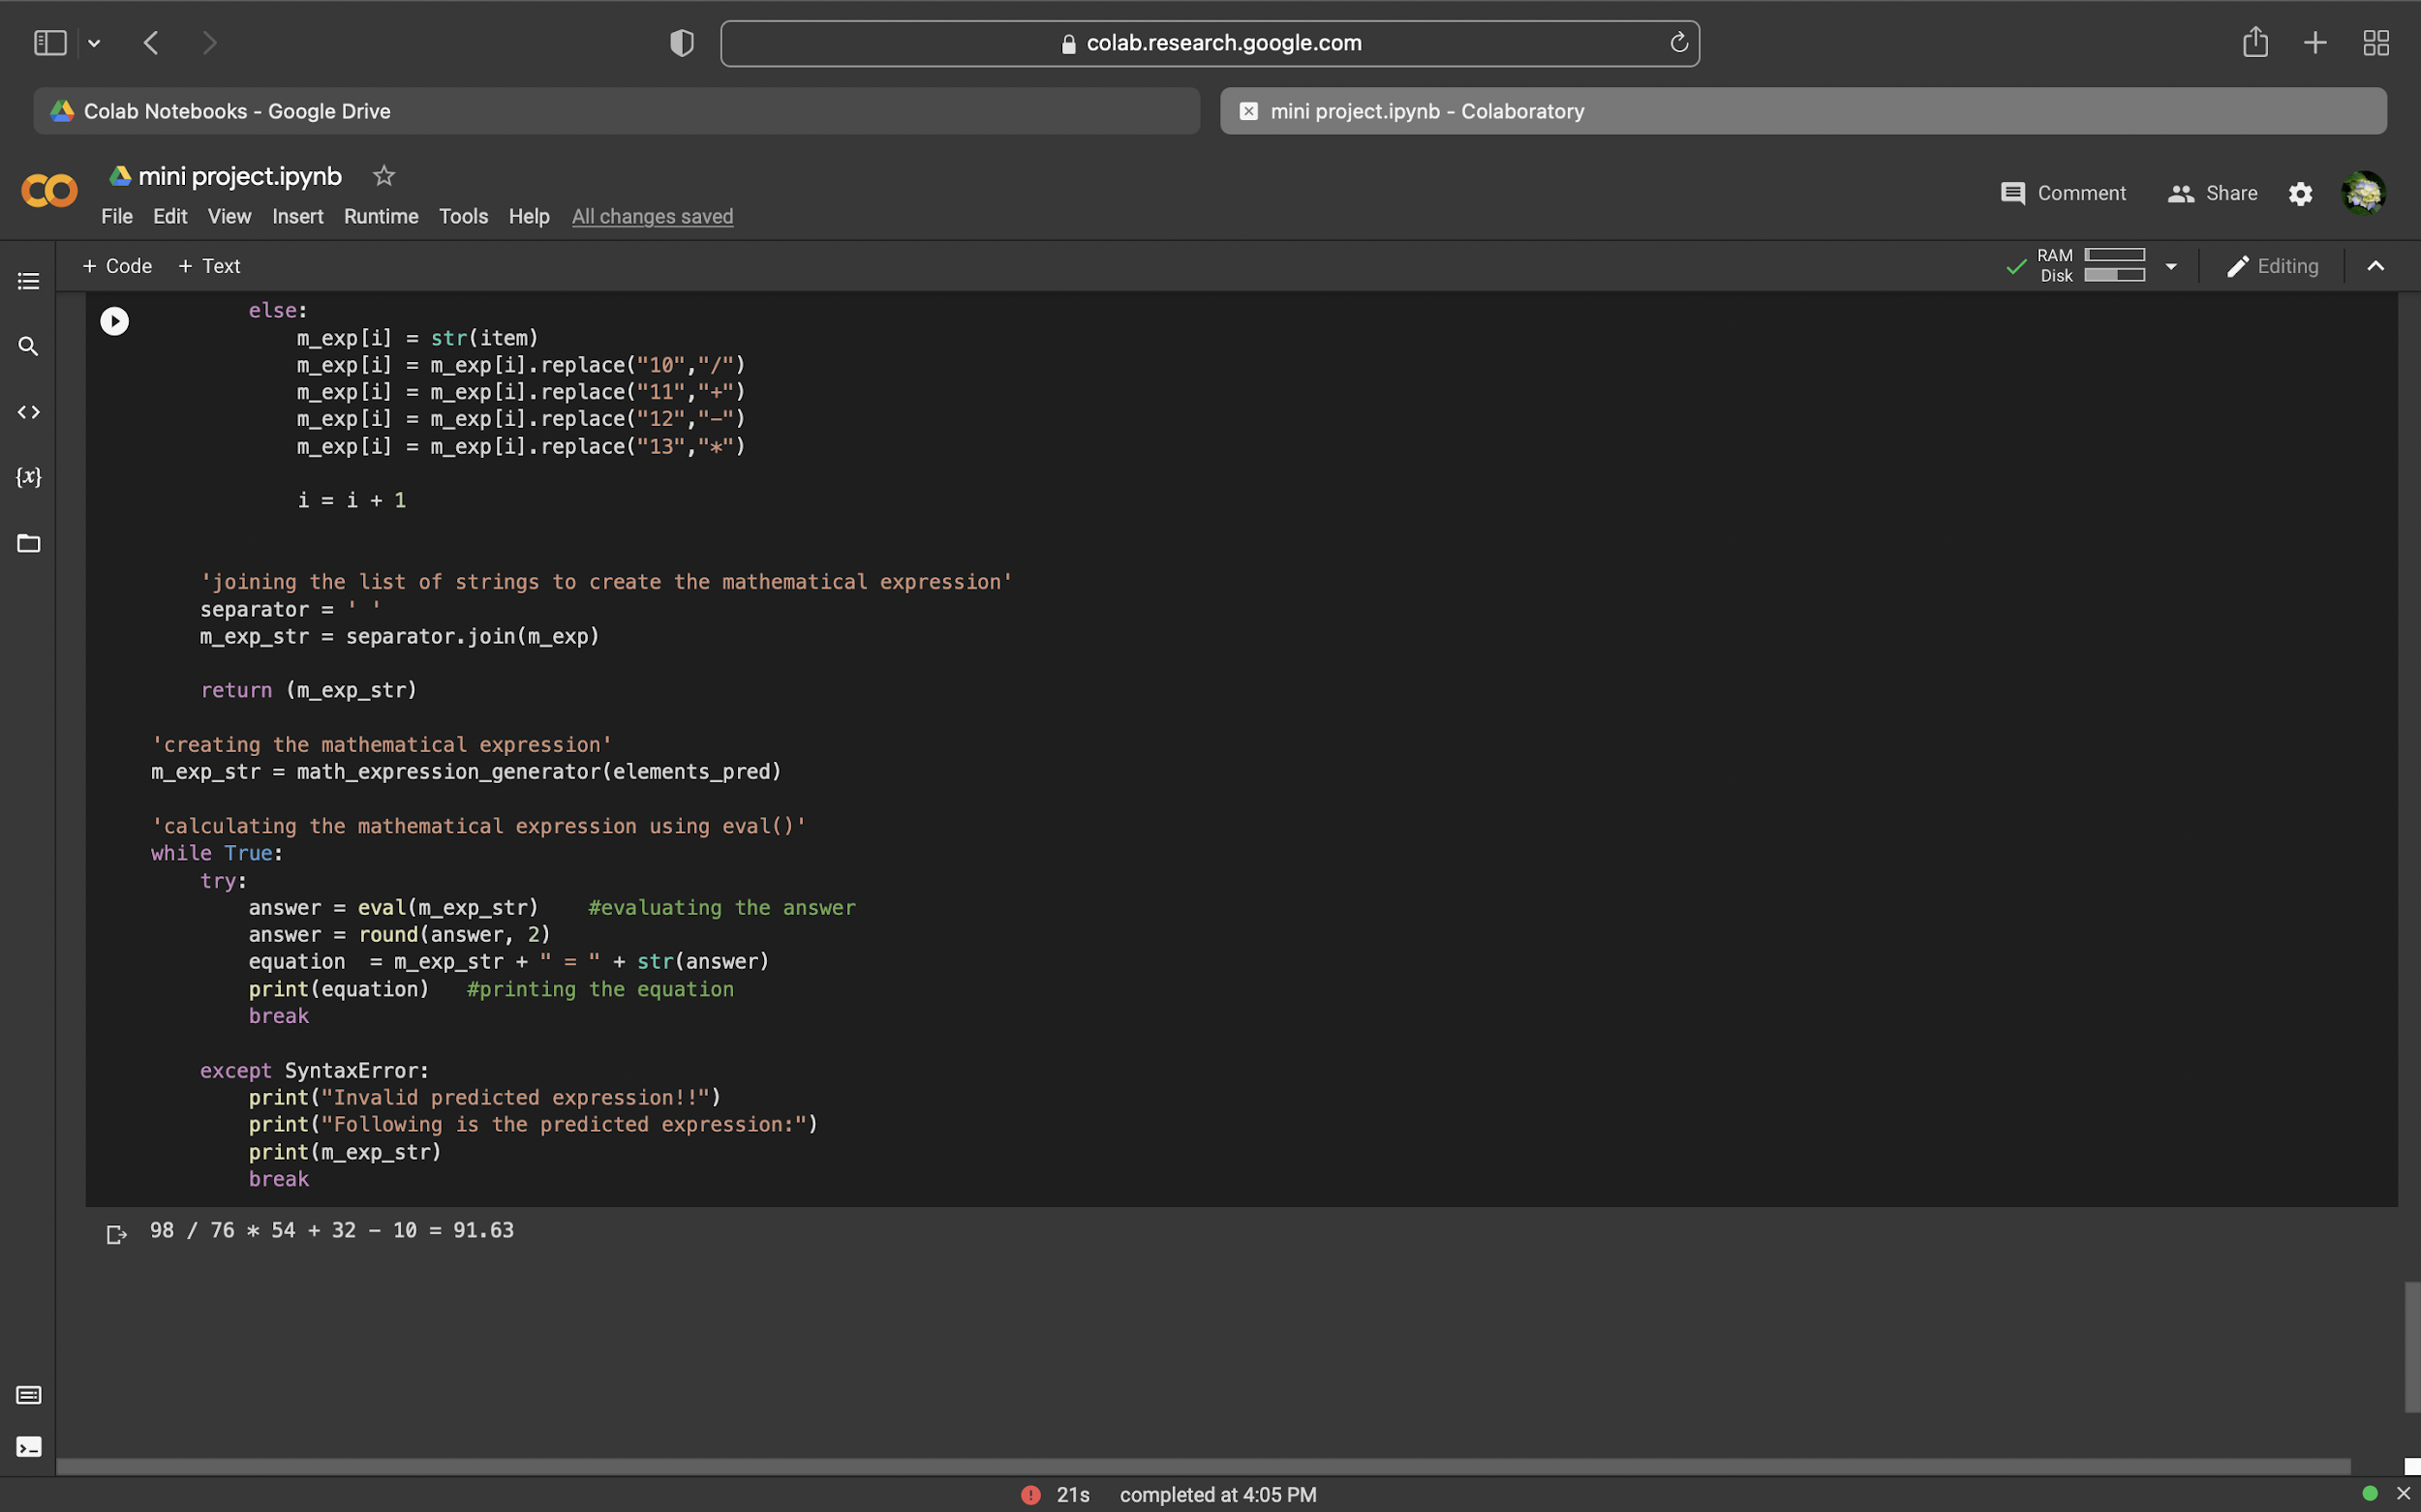

Slide 30
CONCLUSION
The project aims to help us understand how CNN models can be used to make simple tools like the calculator. With the advancement in technology, machine learning and deep learning are playing a crucial role in present times. Now, machine learning and deep learning techniques are being employed in handwriting recognition, robotics, artificial intelligence, and many more fields. Developing such system requires training our machines with data, making it capable to learn and make required prediction. The model gives the perfect answers with an accuracy of 99 percent.

Slide 31
FUTURE SCOPE
What makes Machine learning algorithms so powerful is its ability to learn from its mistakes. In order to do that the model needs to be retrained with correct information. When there is a false prediction, the above code asks for the correct mathematical expression from the user.
It then compares the predicted with the correct expression and identifies the elements that are wrongly predicted.The code then trains the model from its second hidden layer till its output layer using the correct data (first hidden layer is not trained).
The updated model is saved and can be used later to make improved predictions.In the future, these basic concepts can help you perform complex visualization analysis and build sophisticated models.

Slide 32
REFERENCES
https://scihub.hkvisa.net/https://ieeexplore.ieee.org/abstract/document/9298317
https://ieeexplore.ieee.org/document/8640991
https://ieeexplore.ieee.org/document/9225587
https://scholar.google.com/scholar?start=10&q=handwritten+equation+solver&hl=en&as_sdt=0,5

